Slide 1
Multi-Factor Authentication System CS504_01_IN Software Engineering
Thao - Duy
Notes:
We're presenting our Multi-Factor Authentication system, built for CS504 Software Engineering.
This project walks through the design, implementation, and security evaluation of a Flask-based authentication system, from initial idea to what we have running today.

Slide 2
Table of Contents
01.
Architecture
Folder Structure, Application Overview
02.
Core Flows
Registration, Login & Logout
03.
Security Deep-Dives
Cross-Site Scripting, Cross-Site Request Forgery, SQL Injection, Password & PIN Hashing, Input Validation
04.
Second Factor
Registration, Login (PIN)
05.
Session Management
06.
Future Work
Security, Architecture
07.
Live Demo
Notes:
Here's how we'll walk through this.
We'll start with the architecture — how the app is structured.
Then the two core flows, registration and login.
From there we'll go deep into five specific security controls we implemented, followed by a closer look at our second factor and session management.
We'll close with what's still left to do, and if time allows, a live demo.

Slide 3
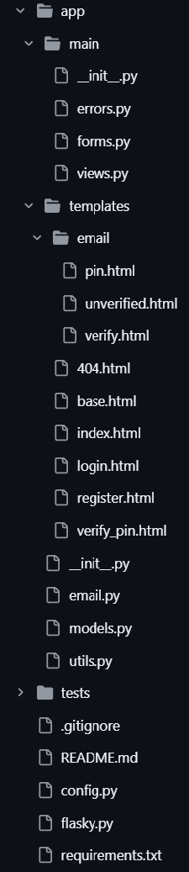
1. Architecture: Folder Structure
app/ | application factory + main blueprint
app/main/ | __init__.py, errors.py, forms.py, views.py
app/templates/ | base.html, index.html, login.html, register.html, verify_pin.html, 404.html
app/templates/email/ | pin.html, unverified.html, verify.html
app/models.py | database models
app/email.py | email sending logic
app/utils.py | helper functions
config.py | configuration and secrets loading
flasky.py | application entry point
tests/ | pytest test suite
requirements.txt | locked dependencies
Notes:
This is how our codebase is organized.
Everything lives under an “app/” package, built with Flask's application factory pattern.
Inside, “main/” holds our routes, forms, and error handling as a Blueprint.
“models.py” defines our database structure,
“email.py” handles outbound email,
and “config.py” keeps secrets separate from the application logic.

Slide 4
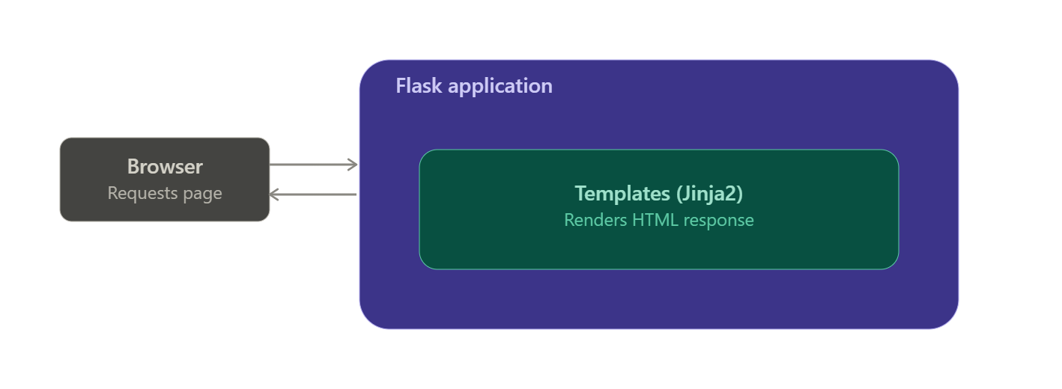
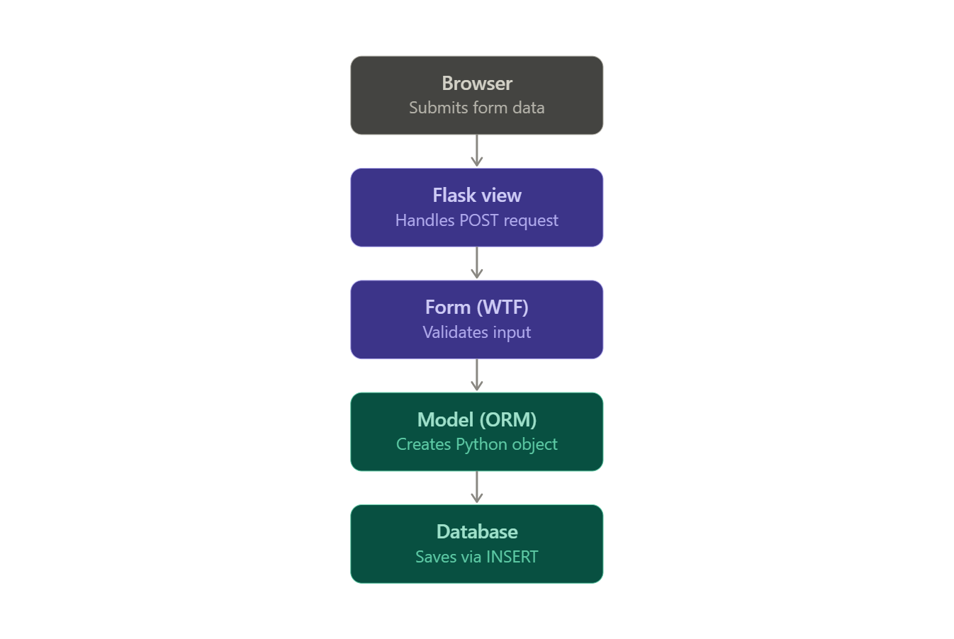
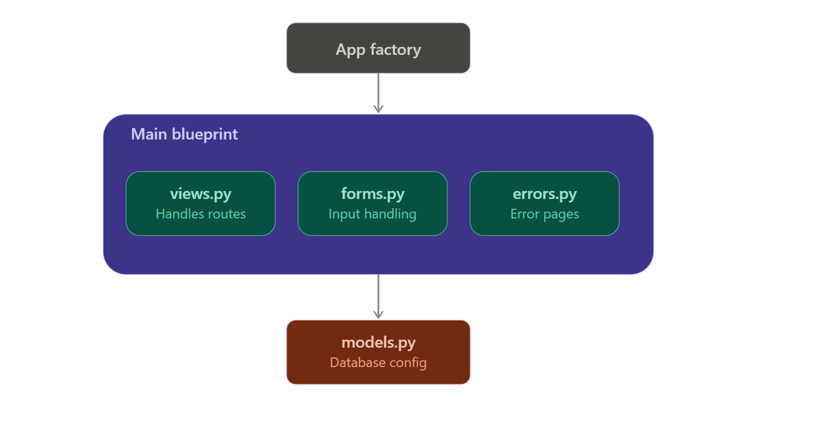
1. Architecture: Application Overview
Three-layer structure: Presentation → Application Logic → Data
a. Presentation: HTML + Jinja2 templates
c. Data: SQLite, accessed through SQLAlchemy ORM
b. Application Logic: Flask, organized via Blueprints
Notes:
Our app follows a standard three-layer architecture.
Presentation — what the user sees — is HTML rendered through Jinja2 templates.
Application logic is Flask itself, handling requests and routing.
And the data layer is SQLite, accessed through SQLAlchemy's ORM rather than raw SQL.
Separating these layers means we can change how something looks without touching the logic underneath,
or change how we query the database without touching our routes.

Slide 5
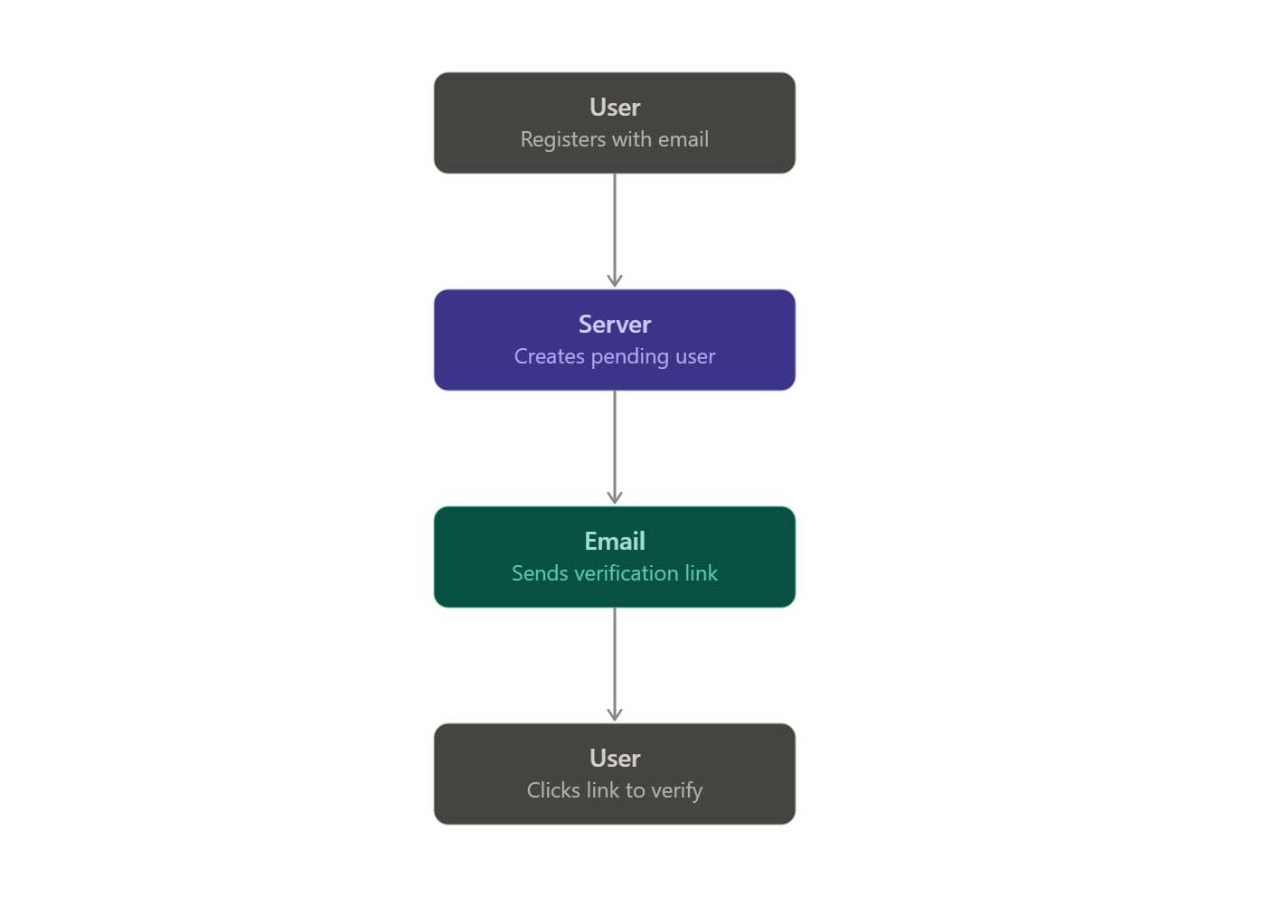
2. Core Flow: Registration
User submits username, password, and email
Server creates a pending (unverified) user record
Verification email sent with a time-limited link (60 min expiry)
User clicks the link → account marked verified
Login is blocked until verification is complete
Notes:
Registration starts simple: username, password, and email.
But the account isn't active yet — we create it as pending.
We immediately send a verification email with a link that expires in 60 minutes.
Until the user clicks that link, they cannot log in at all.
This gives us confidence that the email address is real and actually belongs to the person registering.

Slide 6
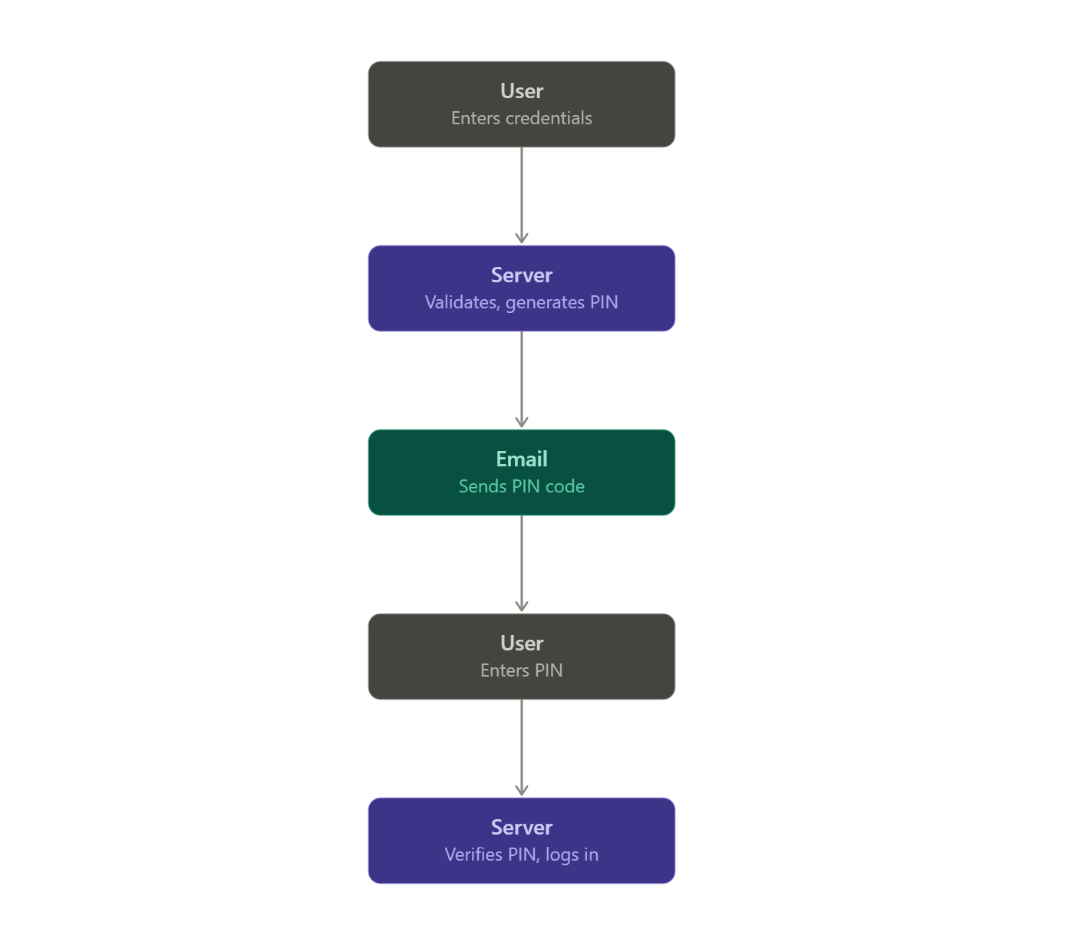
2. Core Flow: Login & Logout
User submits username and password
Server validates credentials, generates a one-time PIN
PIN sent to the user's registered email
User enters the PIN to complete login
Session created via Flask-Login (login_user())
Logout: /logout route calls logout_user(), session invalidated
Notes:
Once verified, login starts with username and password.
If those check out, we generate a one-time PIN and email it.
The user enters that PIN, and only then do we start their session using Flask-Login.
Logging out is just as deliberate: it calls logout_user(), which invalidates the session so the cookie can no longer be used.

Slide 7
3. Security
Cross-Site Scripting (XSS)
Definition: untrusted input executed as script in another user's browser
Solution: Jinja2 auto-escapes template variables by default
Server-side input validation stays enabled at every entry point
Cross-Site Request Forgery (CSRF)
Definition: forged request exploiting a logged-in user's active session cookie
Solution: LoginForm / RegistrationForm inherit from FlaskForm
{{ form.hidden_tag() }} embeds a CSRF token in every form
form.validate_on_submit() checks the token before any logic runs
Notes:
XSS
XSS happens when an attacker sneaks a script into content that later gets rendered in someone else's browser — say, through a username field.
Our defense here is mostly automatic: Jinja2, our templating engine, escapes every variable by default.
So if someone tries to submit “<script>” tags as their username, it just shows up as harmless text on the page.
The one rule we have to enforce ourselves is never using the “|safe” filter on user input, since that's the one thing that turns escaping off.
2. CSRF
CSRF is when an attacker tricks your browser into submitting a request you never intended — while you're still logged in elsewhere.
Our forms inherit from Flask-WTF’s “FlaskForm” class, which gives us CSRF tokens automatically.
Every form embeds one with “form.hidden_tag()”, and we check it with “form.validate_on_submit()” before any login or registration logic runs.
No valid token, no request goes through.

Slide 8
3. Security
SQL Injection
Definition: malicious input altering a SQL query's meaning via string concatenation
Solution: SQLAlchemy ORM — User.query.filter_by(username=username)
Input is bound as a value, never interpreted as code
db.session.add() / db.session.commit() replace manual SQL strings
Password & PIN Hashing
Both password and PIN are hashed before storage using bcrypt
Hashing logic centralized in models.py
bcrypt hashes both values using the Blowfish cipher with a random salt and an adjustable cost factor, making brute-force attacks computationally expensive
Input Validation
Validation logic centralized in forms.py
RegistrationForm defines field-level rules (required, format, uniqueness)
Keeps views.py focused on routing and rendering only
Notes:
3. SQL Injection
SQL injection happens when user input gets concatenated directly into a SQL query, letting an attacker change what that query actually does.
We avoid that entirely by using SQLAlchemy's ORM.
Instead of writing SQL strings, we write things like “User.query.filter_by(username=username)” — the input is always treated as a value, never as part of the command itself.
4. Password & PIN Hashing
Both the password and the PIN are hashed with bcrypt before they're ever stored.
This was actually a fix — earlier in development, the PIN was being compared with a plain equality check, unhashed.
We caught that and moved both hashing operations into our model layer, so neither credential is ever stored or compared in plain text.
5. Input Validation
All of our field-level validation — required fields, formatting, uniqueness checks — lives in “forms.py”, not scattered through our route handlers.
That keeps “views.py” focused purely on routing and rendering,
and it means if we ever need to change a validation rule, there's exactly one place to look.

Slide 9
4. Second Factor: Registration
email and is_email_verified columns added to the User model
Verification token generated with itsdangerous's URLSafeTimedSerializer
Token expires after 60 minutes
Account cannot log in until email is verified
Notes:
To support our second factor, we added two new fields to our User model: “email”, and “is_email_verified”.
The verification link uses a signed, time-limited token
— it expires after 60 minutes, so an old link can't be reused indefinitely.
Until that flag flips to true, the account simply can't log in.

Slide 10
4. Second Factor: Login (PIN)
PIN is no longer chosen by the user at registration
On login, a random 6-digit PIN is generated (Python secrets module)
PIN sent via Flask-Mail to the user's registered email
User enters the PIN to complete authentication
Shifts the second factor closer to "something you have" vs. the original self-chosen PIN
Notes:
Here's where our second factor lives — and it's changed since our earlier design.
Originally, the PIN was something the user picked themselves at registration, alongside their password.
Now, the PIN is generated by the system — a random six-digit code — and emailed at login time.
This matters for a specific reason: a self-chosen PIN is still just something you know, the same category as your password.
A system-generated PIN sent to your inbox is closer to something you have, which is what a real second factor is supposed to be.

Slide 11
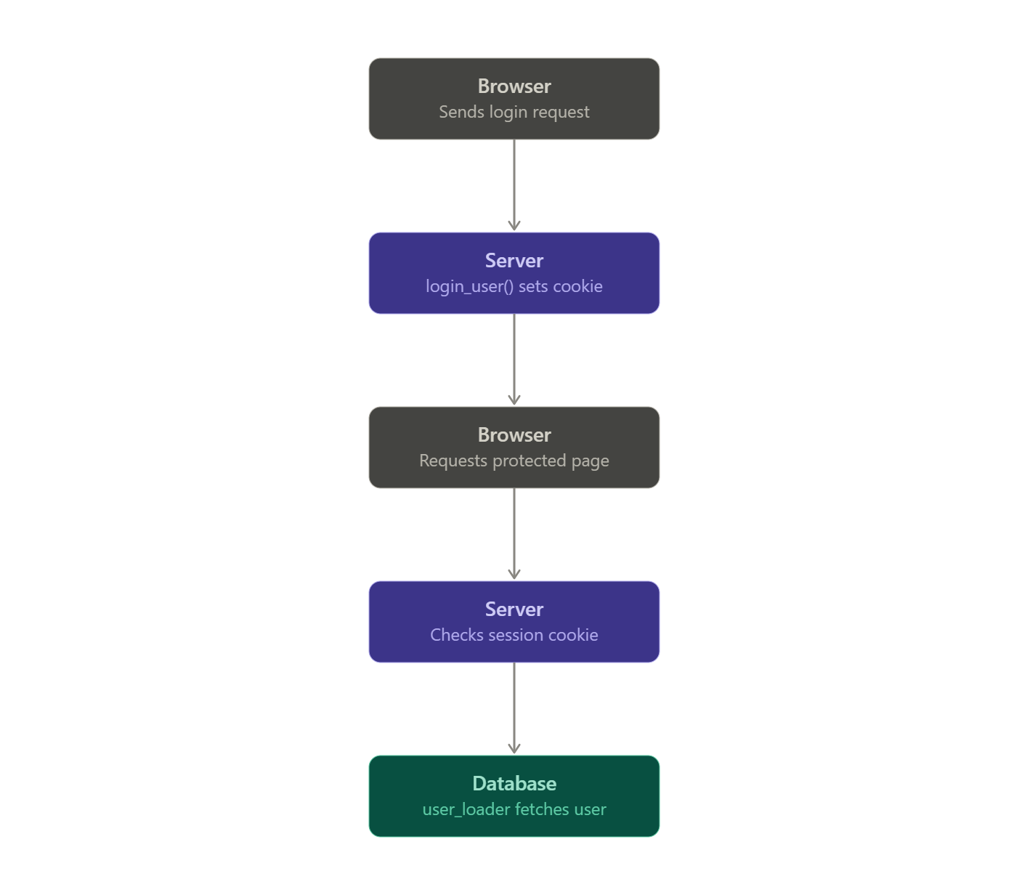
5. Session Management
Flask-Login handles authenticated session state
login_user() on success, logout_user() on logout
@login_required decorator restricts protected routes
Session cookie set after successful login.
Notes:
Once both factors pass, we use Flask-Login to manage the session.
“login_user()” sets a signed cookie containing the user's identity.
On every later request to a protected page, our “@login_required” decorator checks for that cookie,
and a user_loader callback fetches the actual user record from the database.
If either step fails, access is denied — the cookie alone isn't enough, it has to resolve to a real user.

Slide 12
5. Future Work
Security
Architecture
Password strength/complexity validation not yet enforced
Secure cloud deployment (HTTPS, secrets manager vs. .env) not yet implemented
Authentication as a standalone microservice, separated from the main app
UX improvements: Bootstrap styling, page navigation
Scalability: containerization with Docker
Testing orientation: expand pytest suite beyond initial tests
Notes:
Security
There's a few security gaps we're aware of and haven't closed yet.
We don't currently enforce password strength requirements.
Our deployment setup isn't production-hardened
— we're not yet using HTTPS or a proper secrets manager.
And long-term, we'd like to see authentication pulled out into its own standalone service rather than living inside the main application.
2. Architecture
Beyond security, there's architectural work left too.
The frontend needs real styling and navigation
— we haven't implemented that yet.
We'd also want to containerize the app with Docker for easier deployment,
and our test suite is still early-stage and needs to grow to cover more of the application.

Slide 13
6. Live Demo
Register → check email → verify account
Login → check email for PIN → enter PIN → dashboard access
Logout

Slide 14
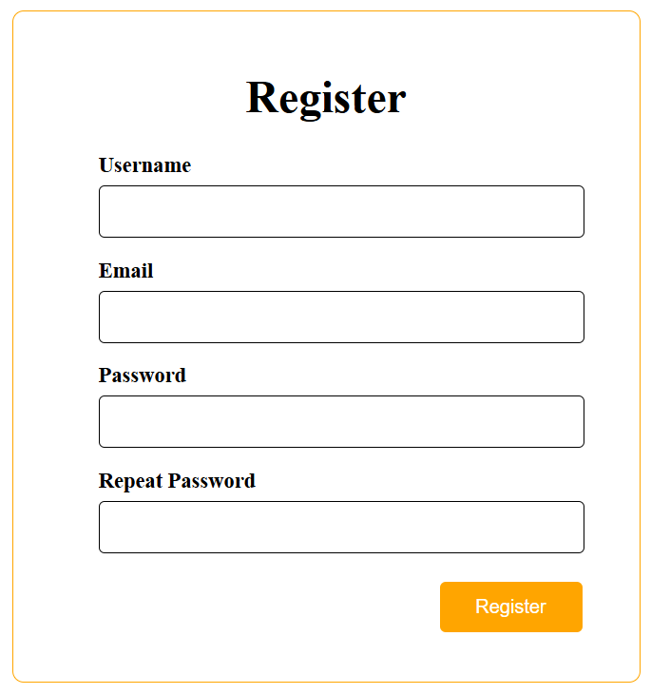
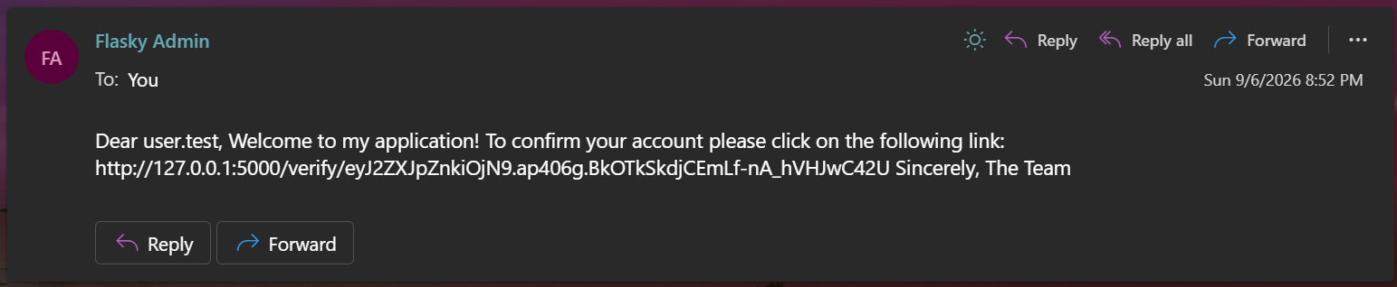
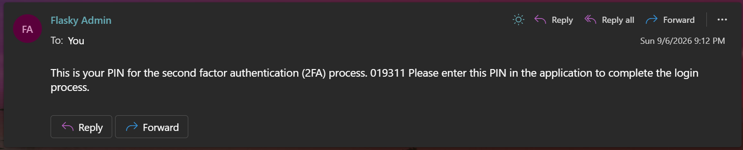
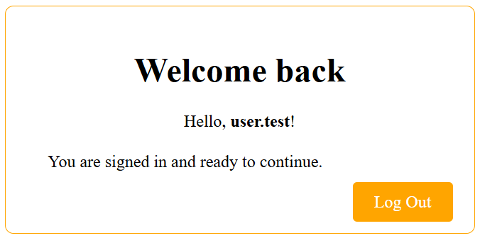
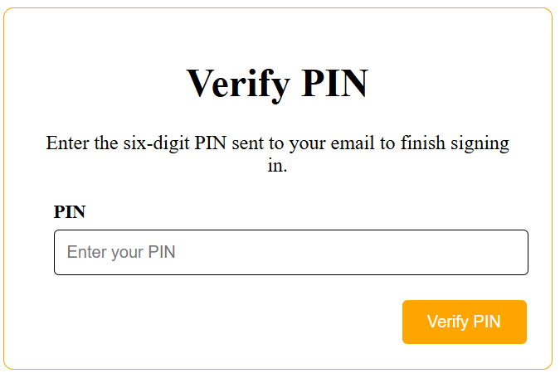
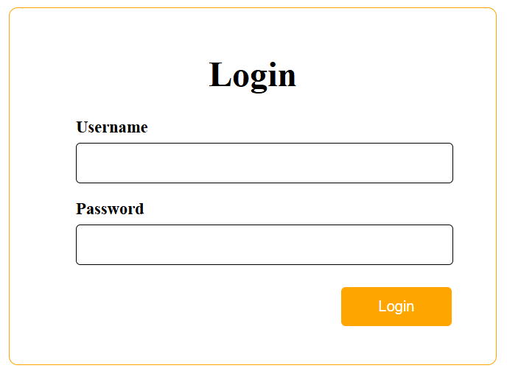
6. Results
Fig2. Activation Email
Fig5. PIN Verify Email
Fig1. Register Form
Fig6. Main page
Fig4. Verify PIN Form
Fig3. Login Form

Slide 15
Thank You for Listening!
CS504
Thao - Duy

